Slide 1
Hamiltonian Circuit
From: Design & Analysis of Algorithm
By Anany Levitin

Slide 2

Hamiltonian Circuit Problem
It is a path that visits all the graph’s vertices exactly once before returning to the starting vertex.
Let us consider the problem of finding a Hamiltonian circuit in the graph in the Figure
We can assume that if a Hamiltonian circuit exists, it starts at vertex a.
We make vertex a the root of the state-space tree.
The first component of our future solution, if it exists, is a first intermediate vertex of a Hamiltonian circuit to be constructed.
Using the alphabet order to break the three-way tie among the vertices adjacent to a.

Slide 3
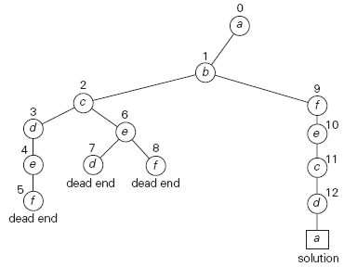
State-space tree for finding a Hamiltonian circuit.
The numbers above the nodes of the tree indicate
the order in which the nodes are generated.

